Slide 1
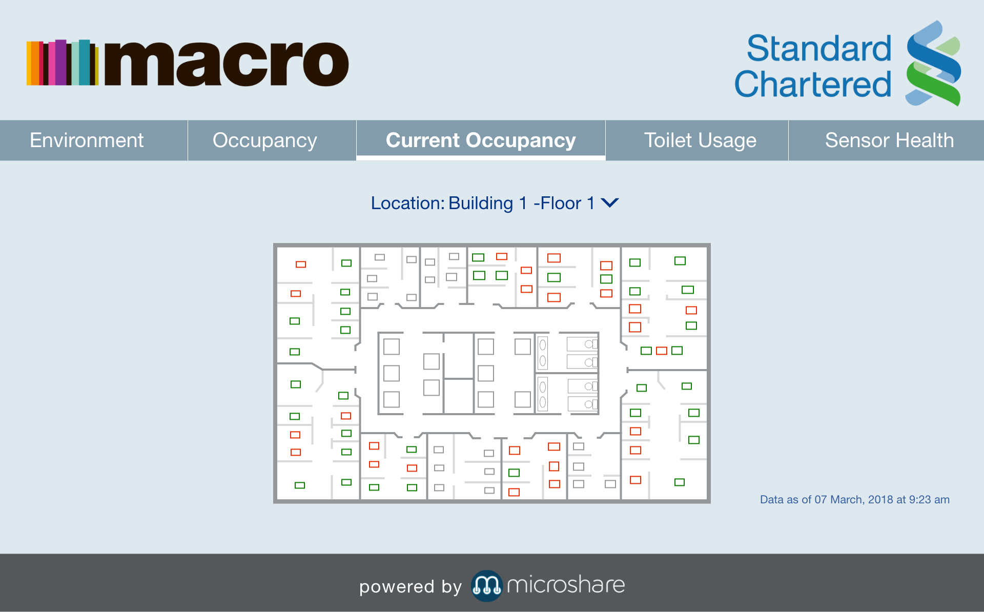
Sample Real-time Desk Availability App

